Slide 1
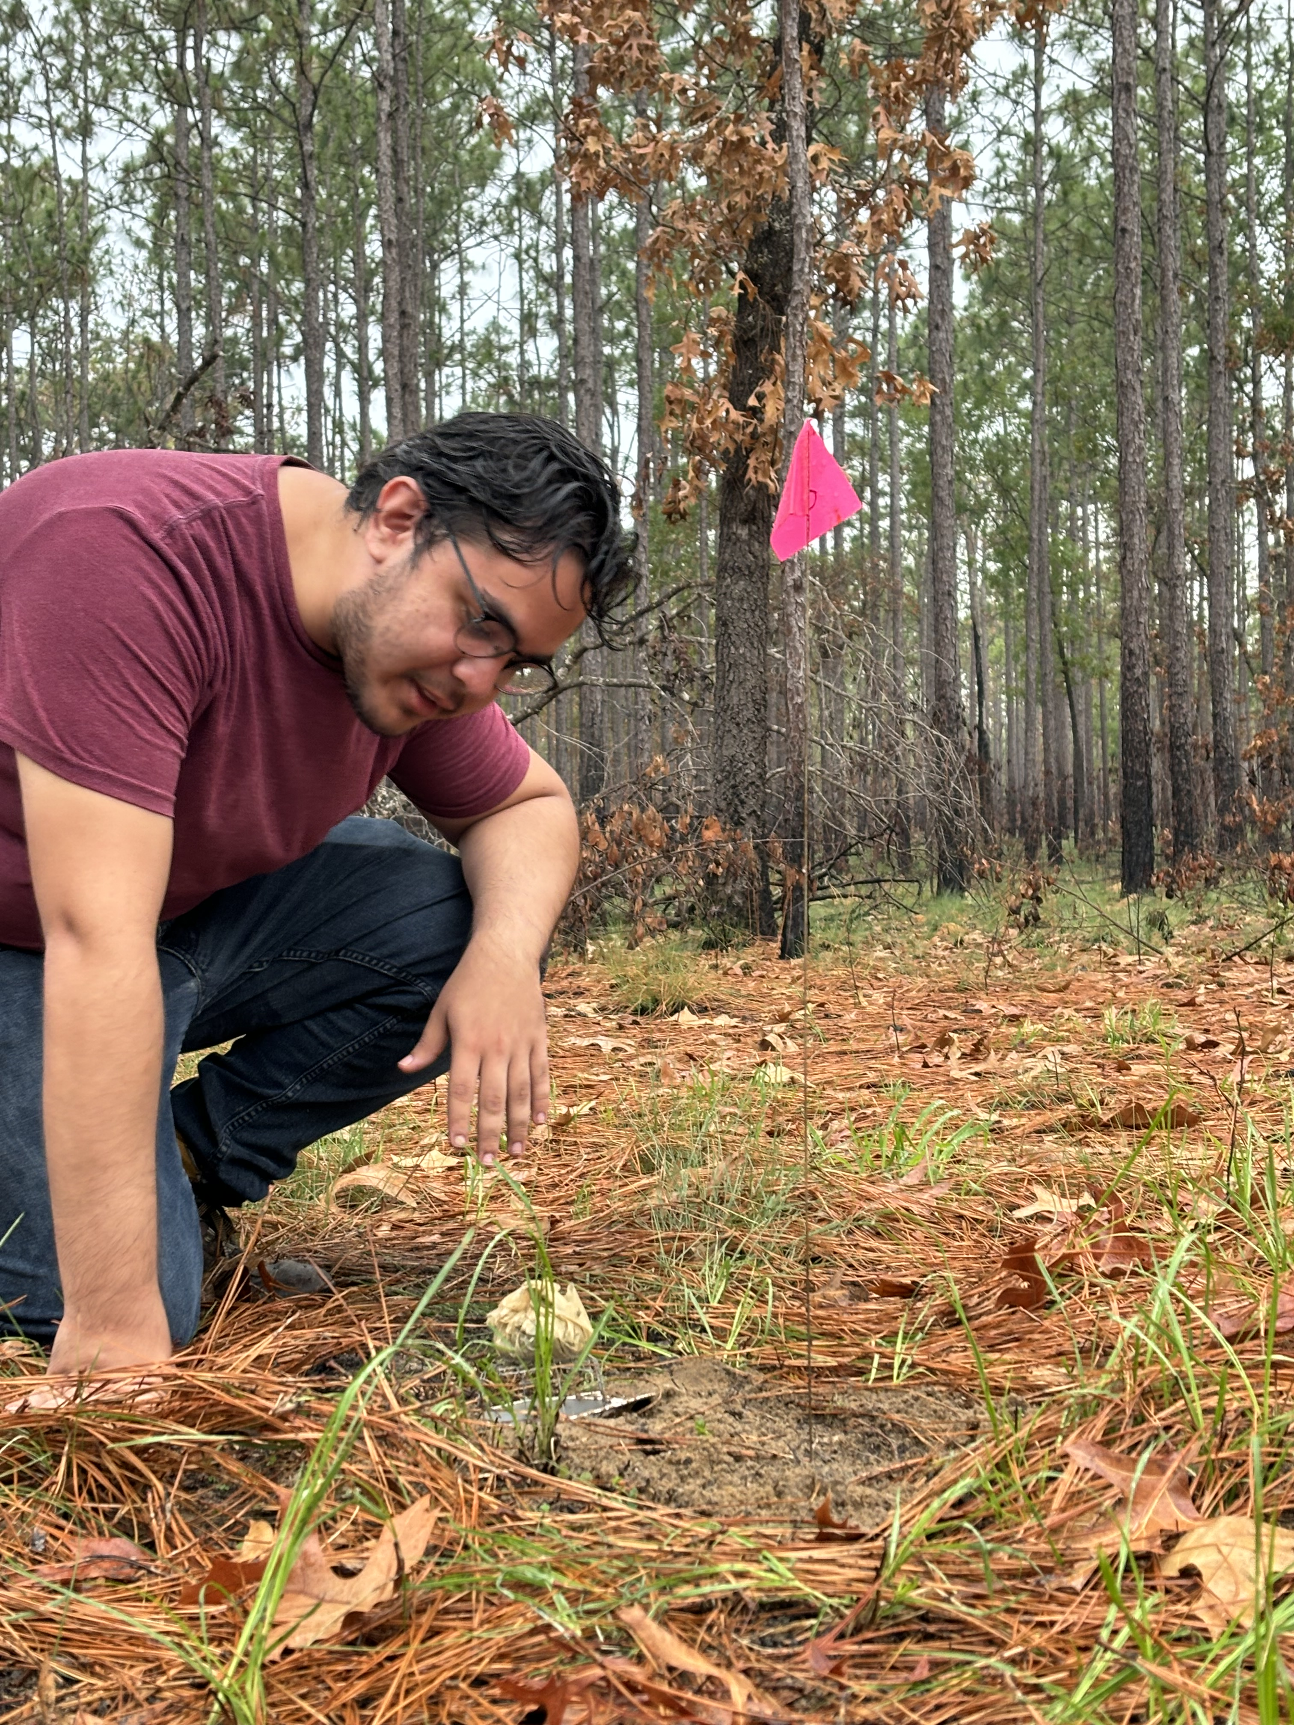
Influence of corridors on dung beetle diversity, dispersal, & ecosystem services
Eric Escobar-Chena
(MS student, UF)

Slide 2
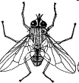
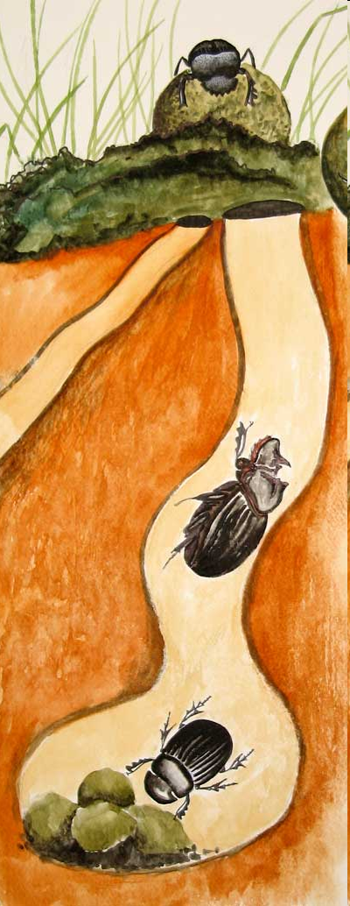
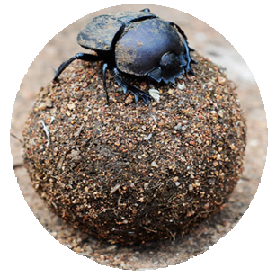
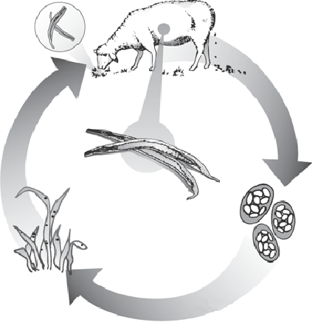

Ecological Functions
Fly and Parasite Suppression
Secondary Seed Dispersal

Slide 3
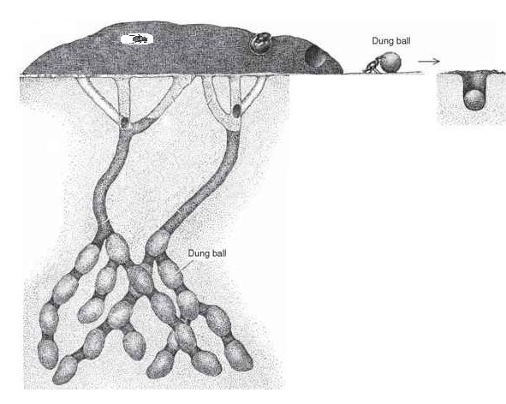
Dwellers, Tunnelers, Rollers

Slide 4
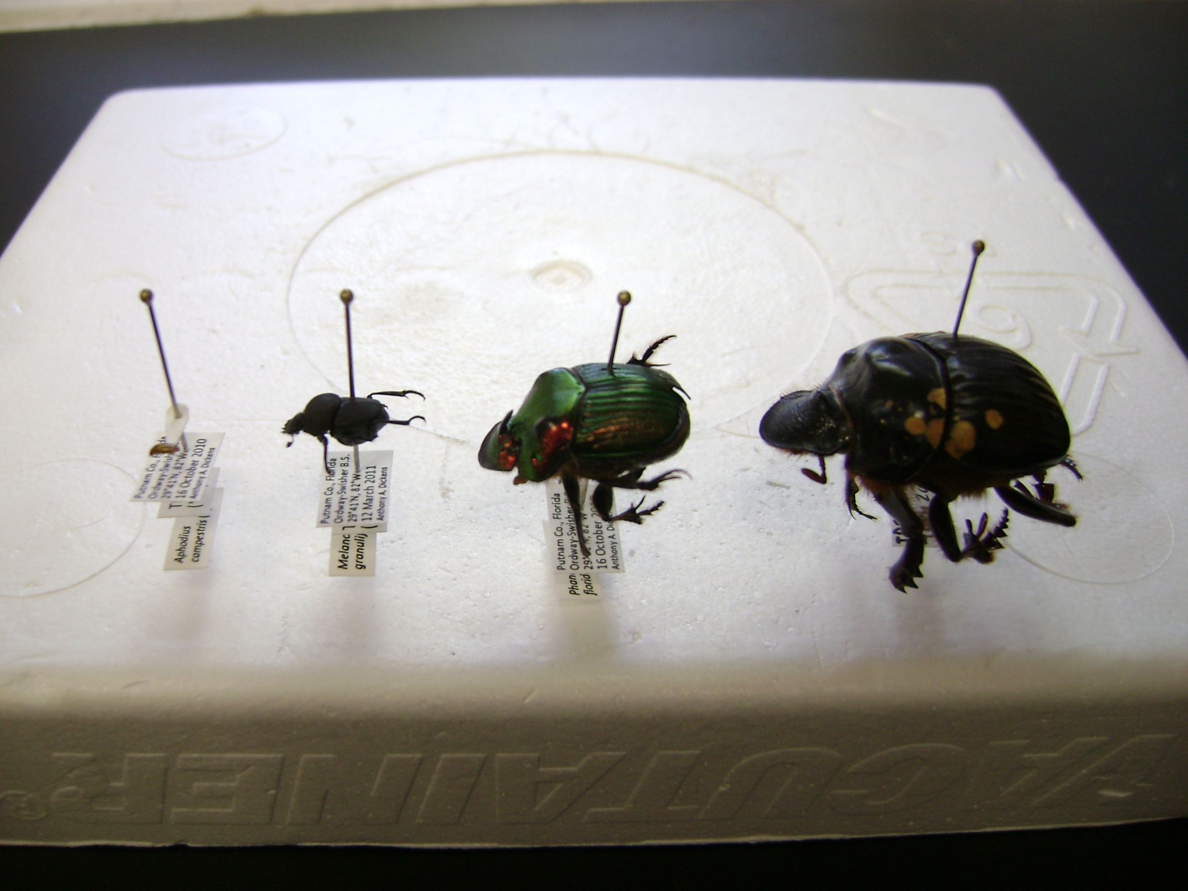
Size Variation
Notes:
Dung beetles with a large body size and body weight are often the most likely to go extinct following land-use change

Slide 5
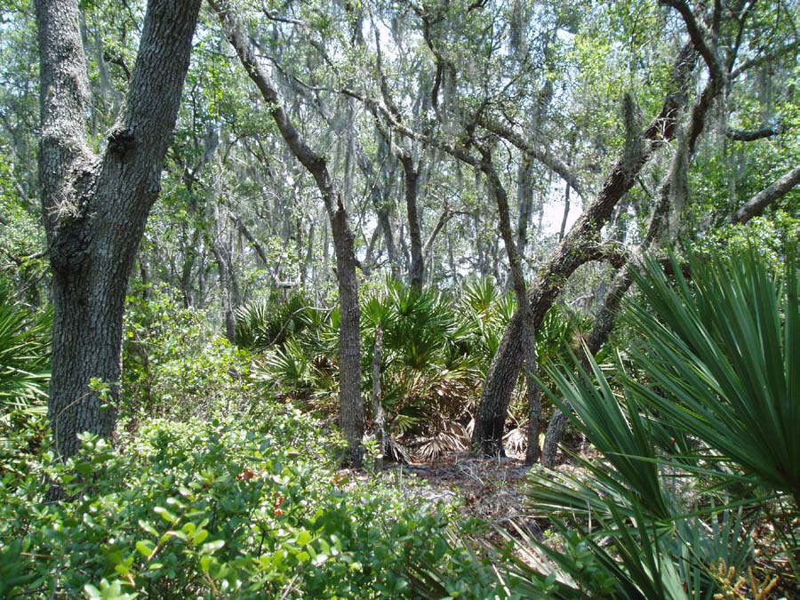
Objectives
● Compare the composition and structure of dung beetle communities in
Sandhill vs Xeric Hammock
● Examine seasonal variability in these patterns

Slide 6
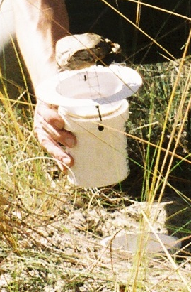
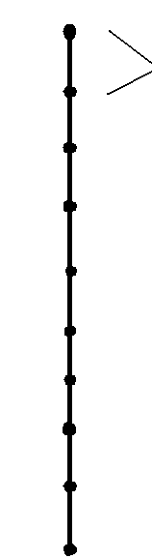
10 Traps
20 meters

Slide 7
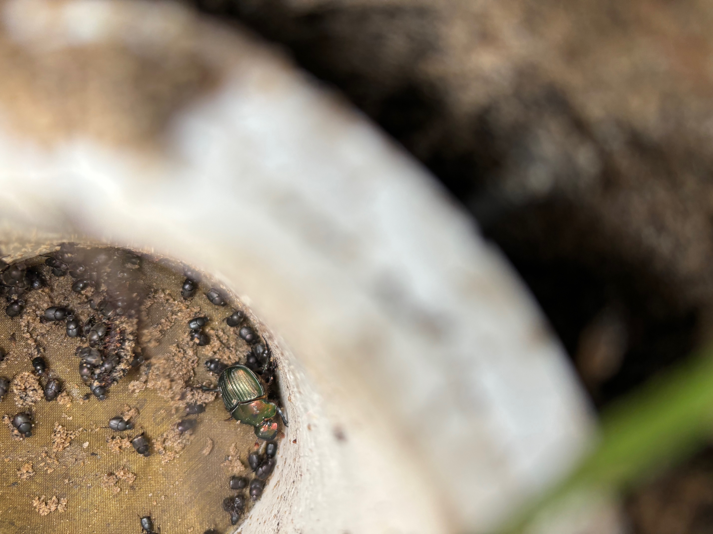

Slide 8
Results
Total Abundance = 23,240
Total Species Richness = 29
26
13411
21
9829
Chao2 estimated true richness
27.2 21.75
18 Shared Species = 62%

Slide 9


Mean Total Seasonal Abundance

Slide 10
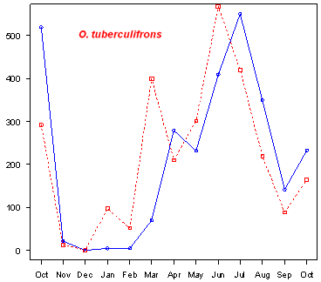
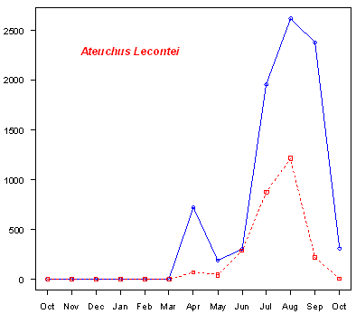
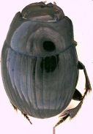
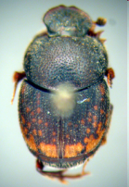
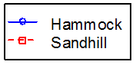
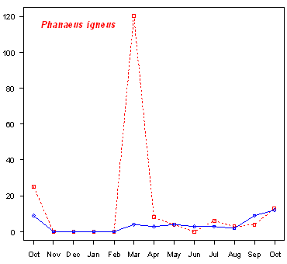
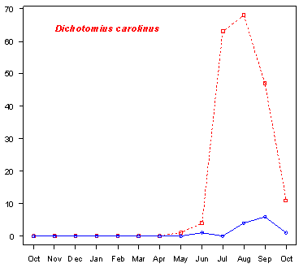
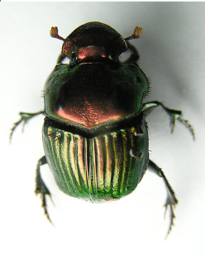
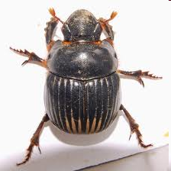
Seasonal Abundance
Ateuchus lecontei
Phanaeus igneus
Dochotomius carolinus

Slide 11
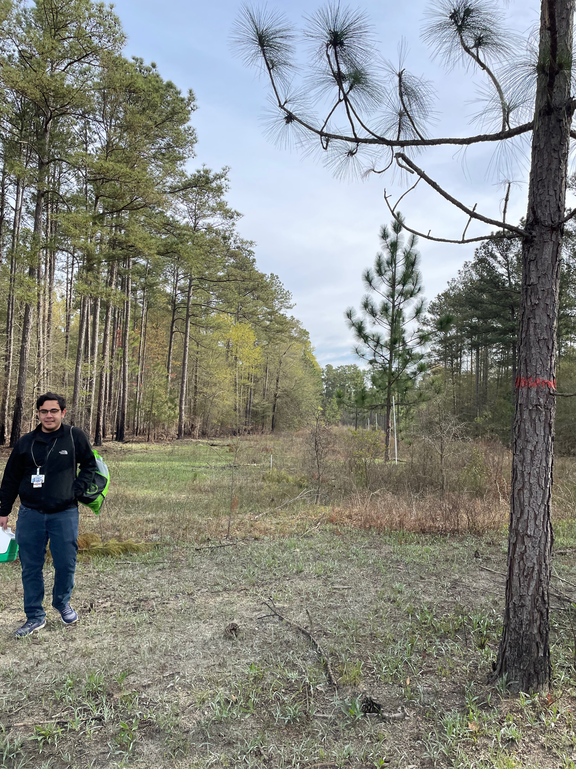
Prediction 1: Species Richness, Species Diversity, and Functional Diversity will be higher in patches connected by corridors than in unconnected patches.
Prediction 2: Dung removal rates will be highest in connected patches. This is due to the higher functional diversity of beetles in these locations.
Prediction 3: Corridors facilitate the dispersal of all species. However, the speed at which in individuals move through corridors and the probability of successful inter-patch movement is size-dependent (i.e., larger beetle species move more quickly and are more likely to reach the connected patch).

Slide 12
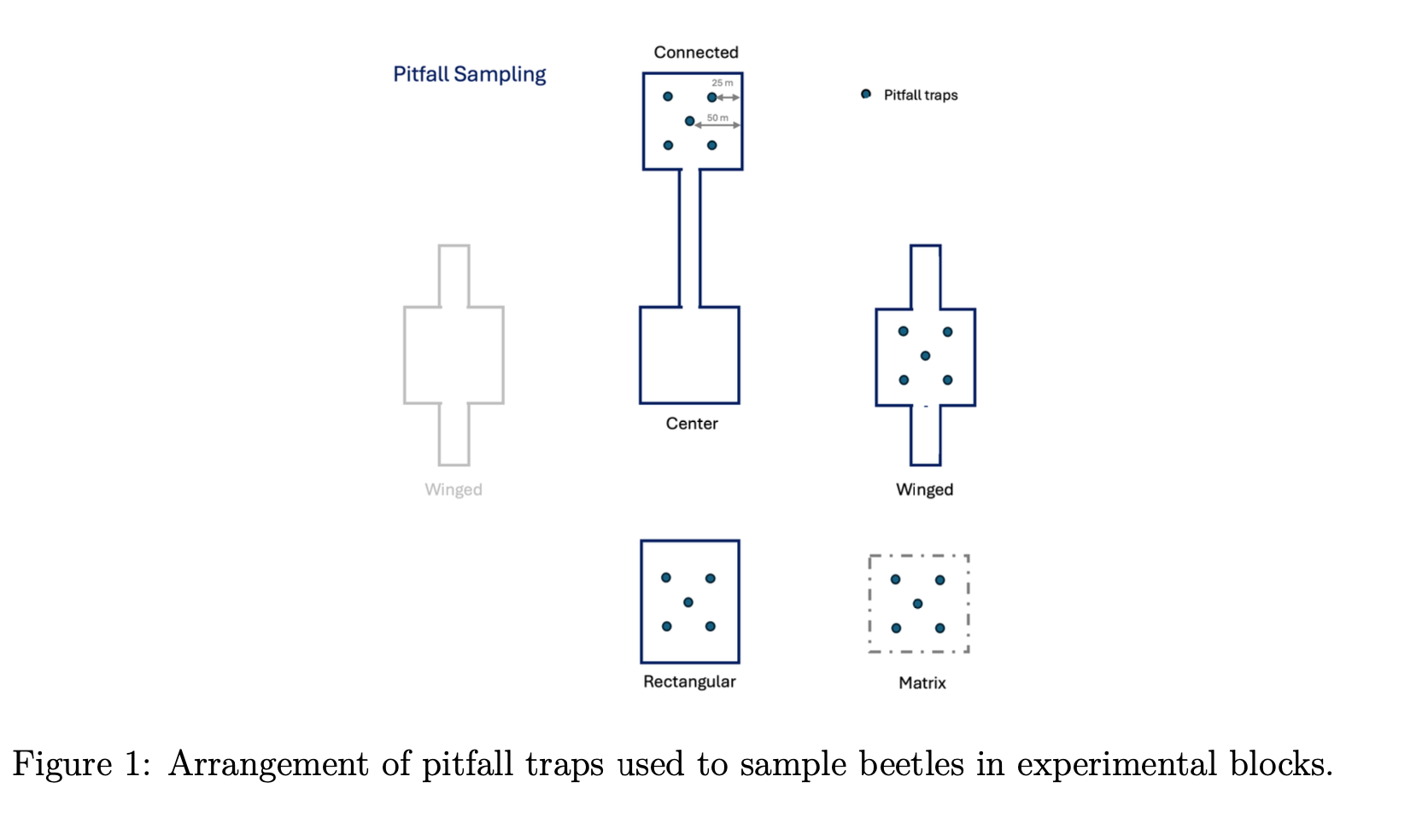

Slide 13
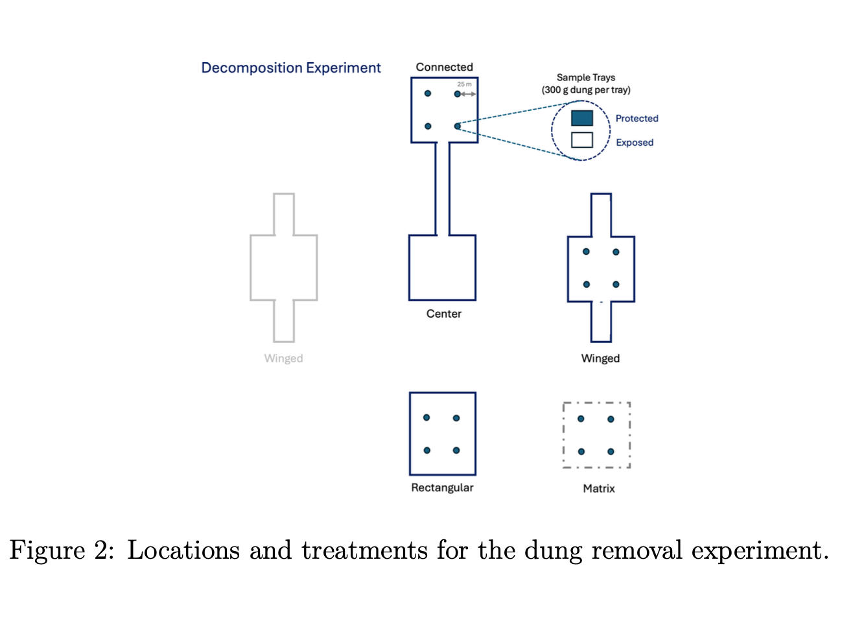

Slide 14
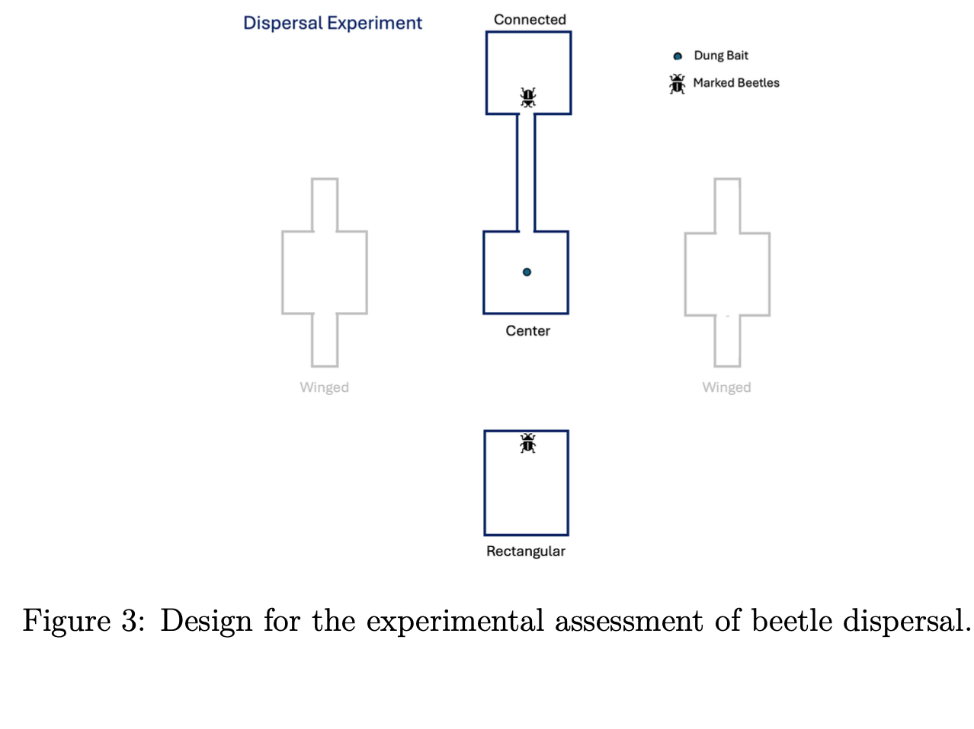

Slide 15
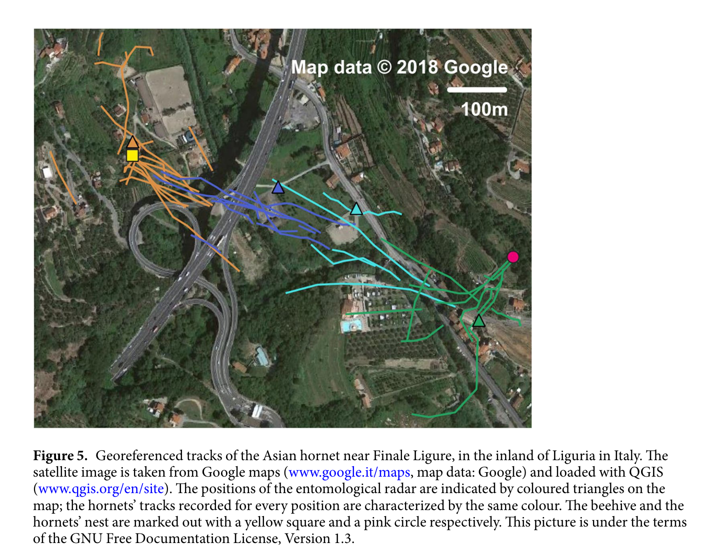
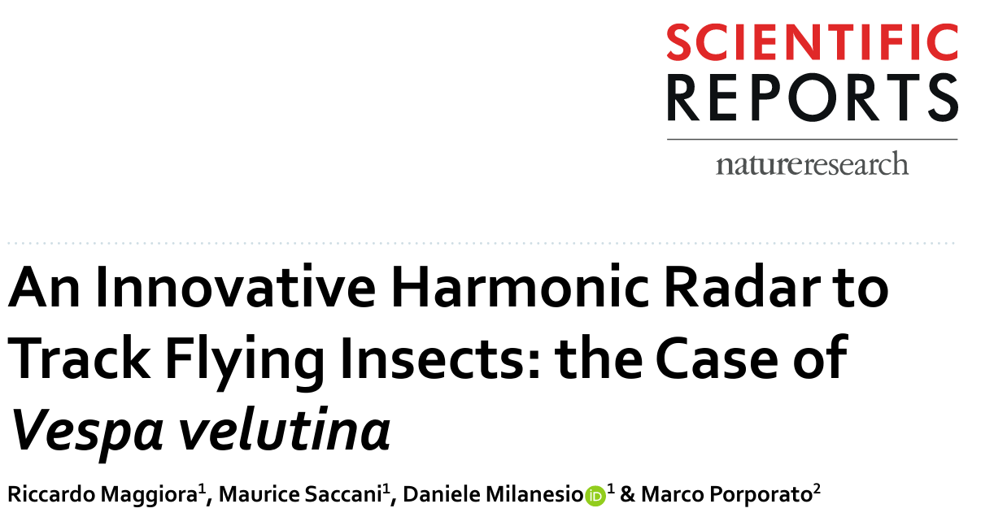

Slide 16
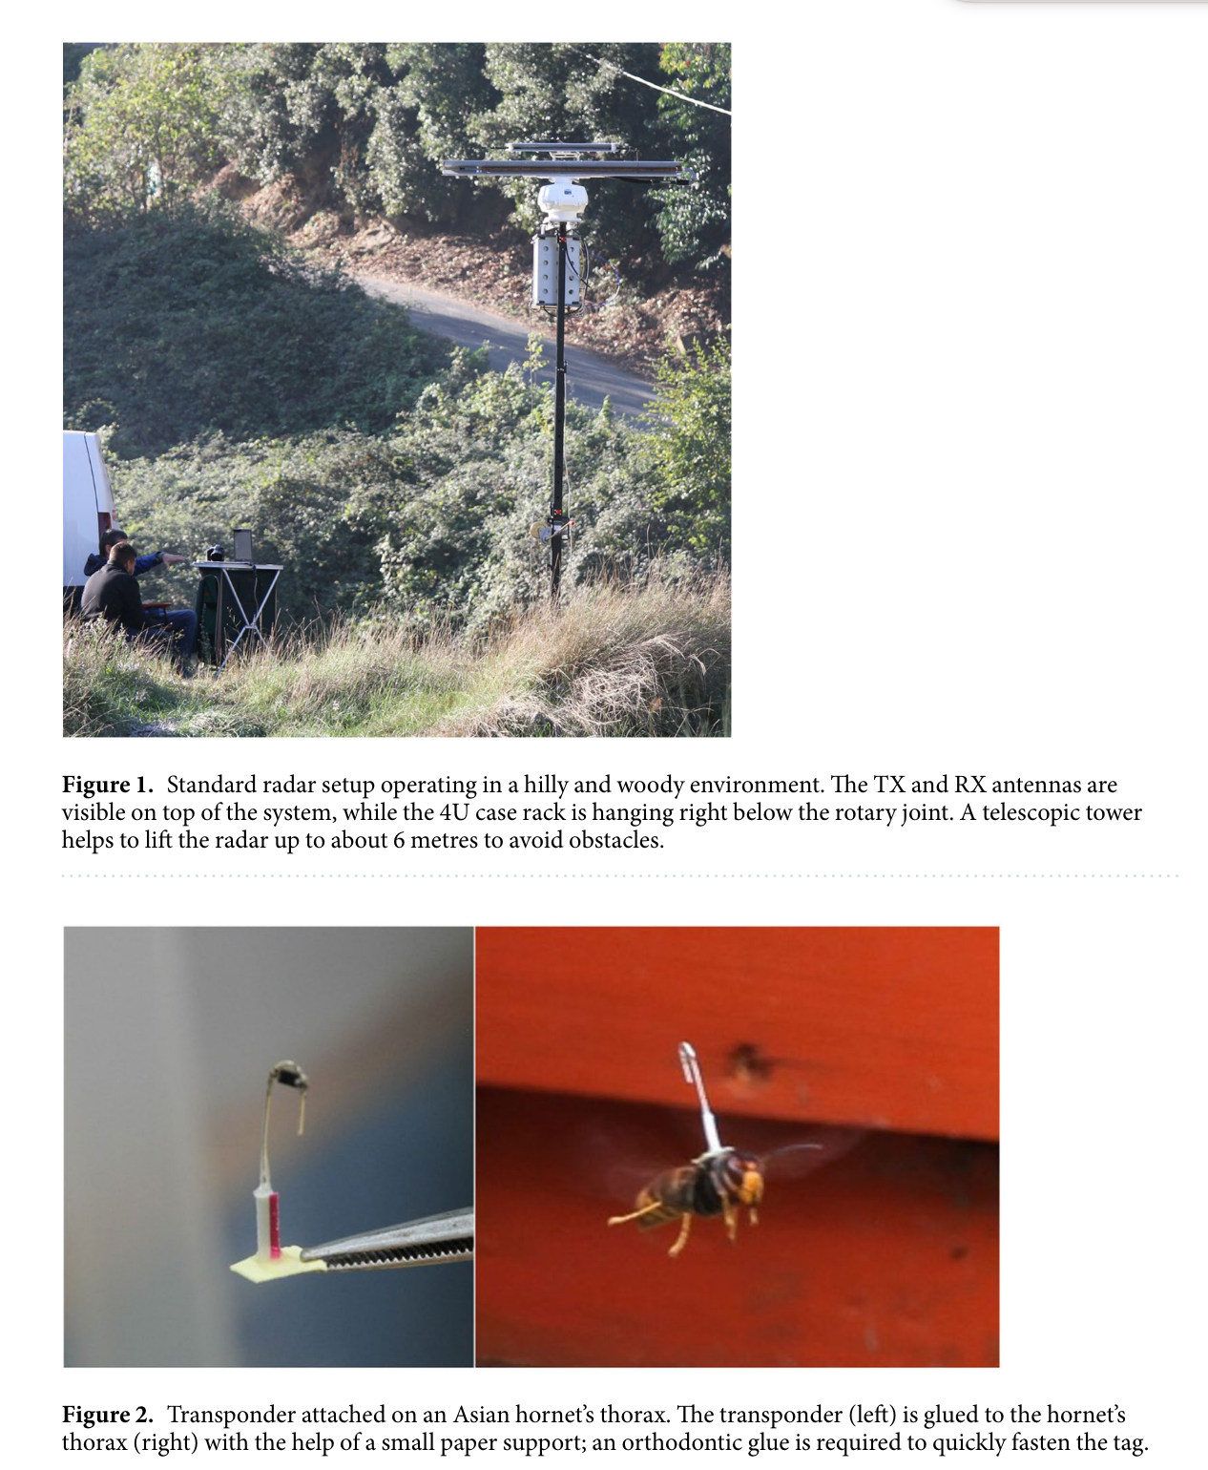

Slide 17
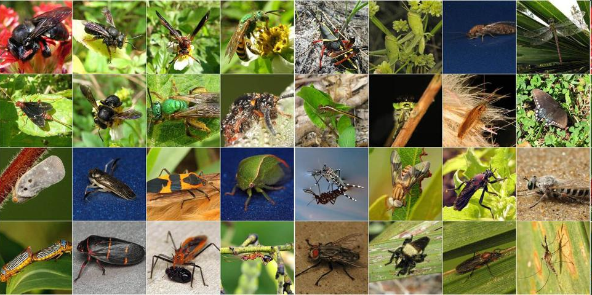
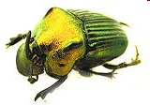
Dung Beetles as Indicators

Slide 18
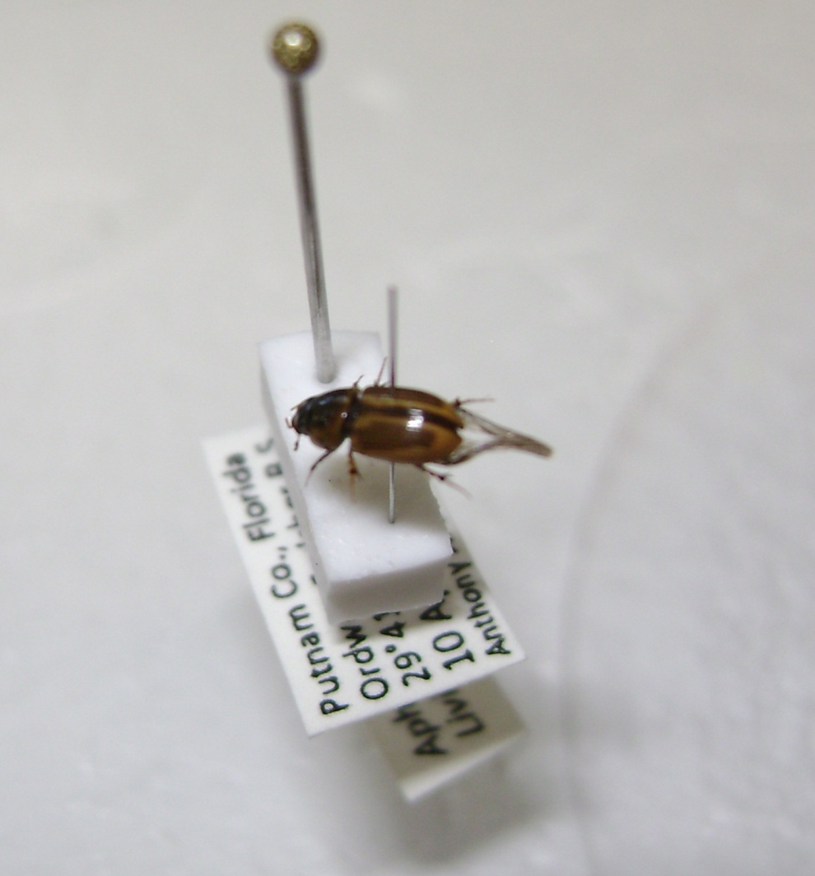
Exotics Found
One individual Aphodius lividus
(out of 23,240 beetles collected)

